Slide 1
The Relationship Between Traffic Counts and Road Accidents
By: Mousa Tams Elisheva klapish
Lidor Eliyahu Shelef

Slide 2

Introduction
We combined traffic count data from multiple years with accident data, using Python for data processing and QGIS for spatial analysis and visualization.
In this project we tried to analyze the relationship between traffic volumes and road accidents in Israel using a Geographic Information System Scope (GIS).

Slide 3

01
DATA Collecting

Slide 4
DATA Collecting
Our main data source was government public use files.
Data was grouped into years from 2014 to 2023.
Salvageable data was from 2016 to 2021.
To start understanding the data we plugged 2021 into QGIS.

Slide 5

Types of files
Traffic Counts
Accidents
Roads

Slide 6
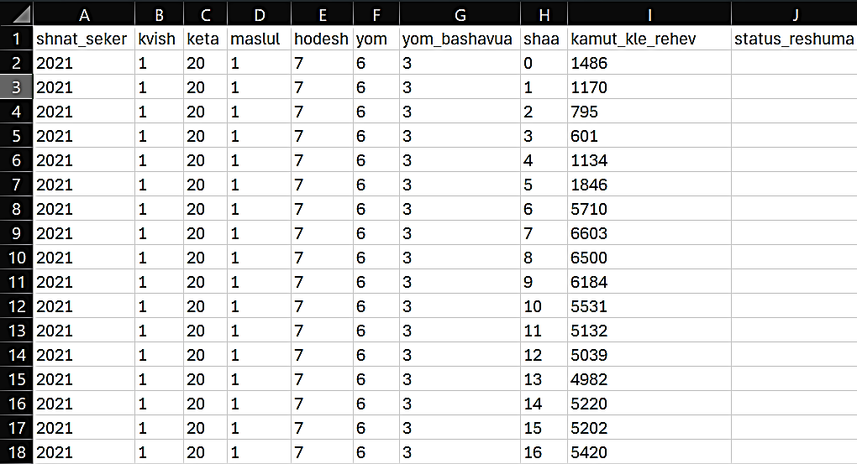

The Data: Traffic Counts

Slide 7

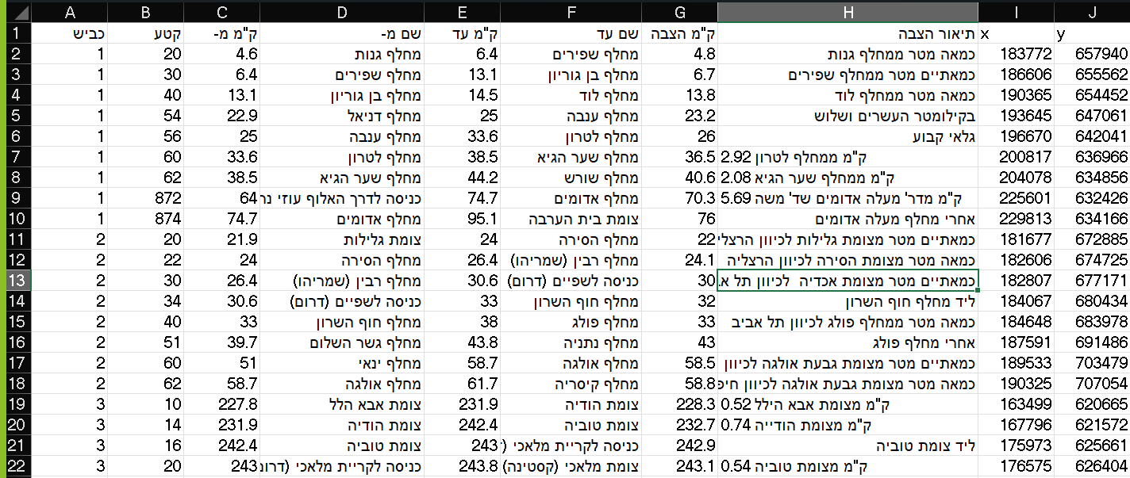
The Data: Roads

Slide 8
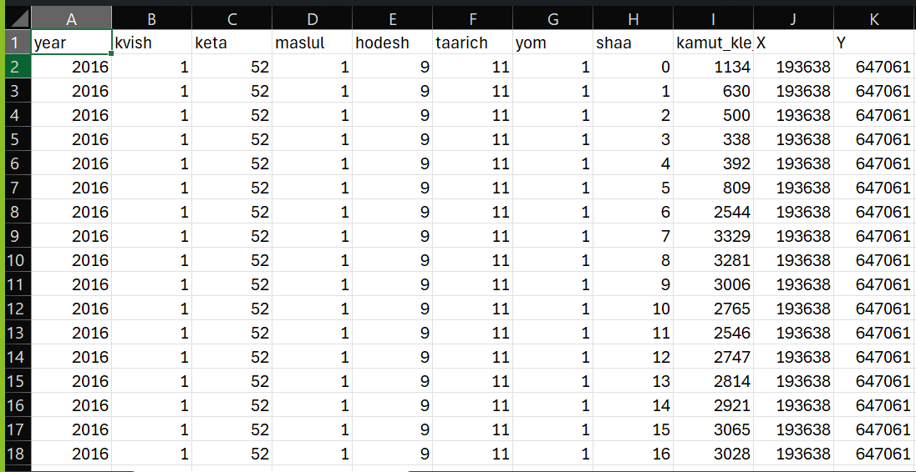
The Data: Traffic counts after the merge with roads
Now that we have X, Y data we can visualize the data in QGIS !

Slide 9
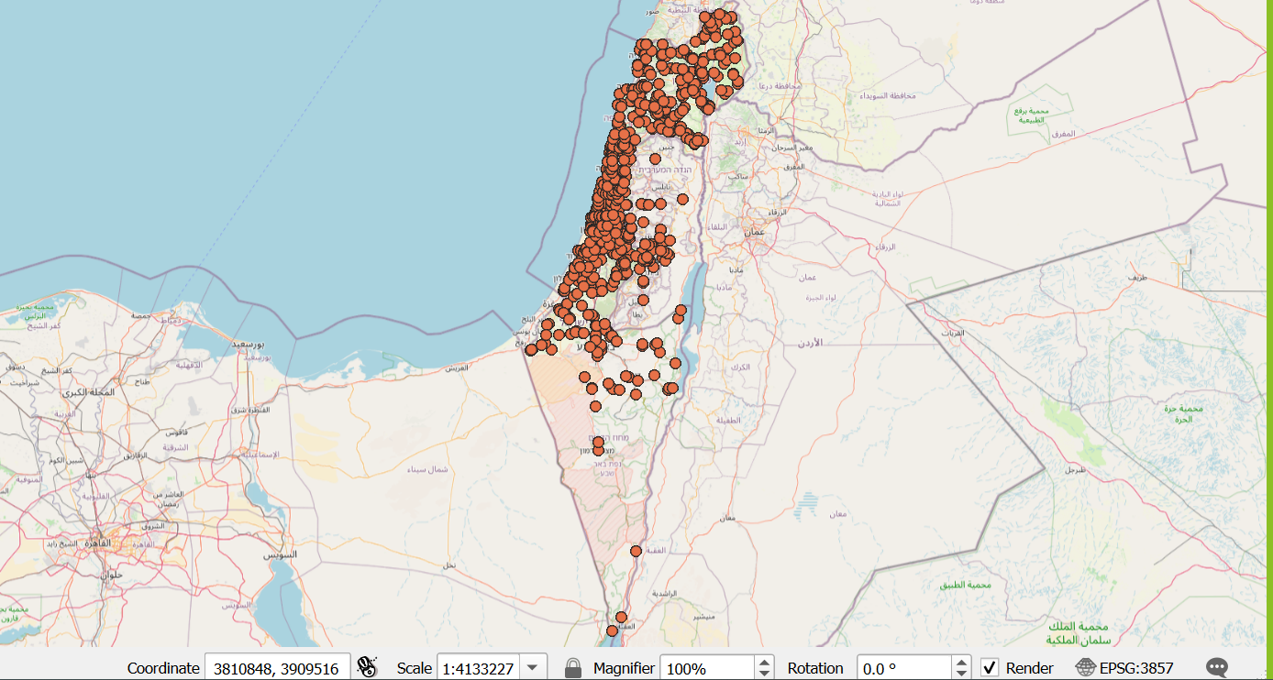
The Data: Traffic Counts after the merge with roads on QGIS
Each point we see on the map is a “radar” that count cars in intervals of 1 hour the whole year

Slide 10
The Data: Accidents
pk_teuna_fikt: Unique ID
sug_tik: Case Type
THUM_GEOGRAFI: Geographic Area
SUG_DEREH: Road Type
SEMEL_YISHUV: Settlement Code
REHOV1: Street 1
REHOV2: Street 2
BAYIT: House Number
ZOMET_IRONI: Urban Junction
KVISH1: Road 1
KVISH2: Road 2
KM: Kilometer Mark
ZOMET_LO_IRONI: Non-urban Junction
YEHIDA: Unit
SHNAT_TEUNA: Accident Year
HODESH_TEUNA: Accident Month
SHAA: Hour
SUG_YOM: Day Type
YOM_LAYLA: Day/Night
YOM_BASHAVUA: Weekday
HUMRAT_TEUNA: Accident Severity
SUG_TEUNA: Accident Type
HAD_MASLUL: Single Lane
RAV_MASLUL: Multi Lane
MEHIRUT_MUTERET: Speed Limit
TKINUT: Road Condition
ROHAV: Road Width
SIMUN_TIMRUR: Traffic Signs
TEURA: Lighting
MEZEG_AVIR: Weather
PNE_KVISH: Road Surface
SUG_EZEM: Object Type
MERHAK_EZEM: Object Distance
LO_HAZA: Obstruction
OFEN_HAZIYA: Visibility
MEKOM_HAZIYA: Visibility Location
KIVUN_HAZIYA: Visibility Direction
MAHOZ: District
NAFA: Sub-district
EZOR_TIVI: Natural Area
MAAMAD_MINIZIPALI: Municipal Status
ZURAT_ISHUV: Settlement Form
STATUS_IGUN: Road Status
X: X Coordinate
Y: Y Coordinate

Slide 11
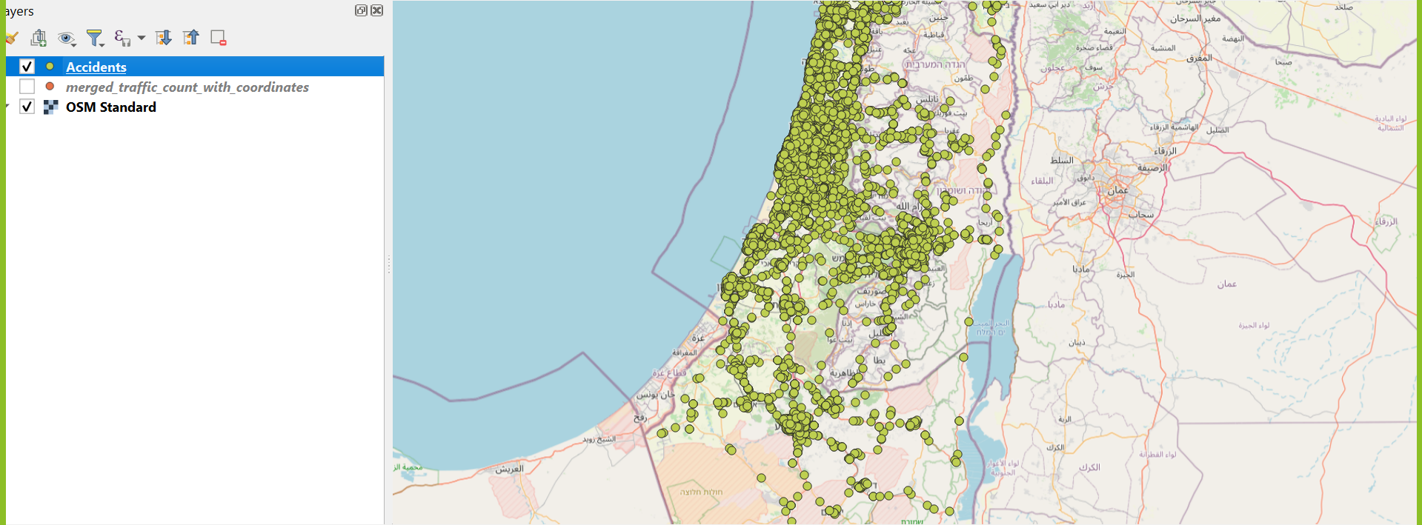
The Data: Accidents
Since we have X,Y data we can plot it AS IS.
Notice that many accidents occurred on roads where we don't have any (‘RADARS'). Therefore, we need to merge the accident data with the traffic count data to better analyze these incidents …
Notes:
אילת
את כל קוד הפייתון הרצנו בקולאב.
השלב הראשון בהתמודדות עם הקבצים היה מחיקת מידע לא רלוונטי: שורות none, עמודות לא רלוונטיות, עמודות כפולות וכו'. יצרנו לשם כך את הפונקציות הגנריות שניתן לראות כאן. בנוסף בשביל פיתוח עמוד האינטרנט הוספנו את הפונקציות ששומרות את המידע לjson או לgeojson.
את קוד הניקוי הראשוני לקובץ הגילאים ניתן לראות למעלה, מאחר ומדובר בקובץ המכיל מידע גאוגרפי השתמשנו בgeopandas על מנת לקרוא אותו.את קוד הניקוי הראשוני של קובץ החנויות ניתן לראות למטה, מאחר ומדובר בקובץ אקסל רגיל השתמשנו בpandas.

Slide 12
Steps to merge traffic count with accident
Loading Datasets: Loaded traffic and accident data into DataFrames, focusing on key columns like kvish, keta, yom, kamut_kle_rehev, KVISH1, KVISH2, HUMRAT_TEUNA, X, Y.
Column Standardization: Standardized column names (e.g., HODESH_TEUNA to hodesh, YOM_BASHAVUA to yom).
Aggregating Traffic Data: Calculated the average traffic volume for each road segment on each day of the week.
Merging Data: Merged aggregated traffic data with accidents using KVISH1 and KVISH2, creating a single Data Frame with accidents and average traffic volume.
Exporting Data: Exported the final merged dataset for QGIS visualization.
Next Steps
Visualize traffic volume vs. accident severity in QGIS.
Identify spatial patterns or correlations between traffic volume and accident severity.

Slide 13
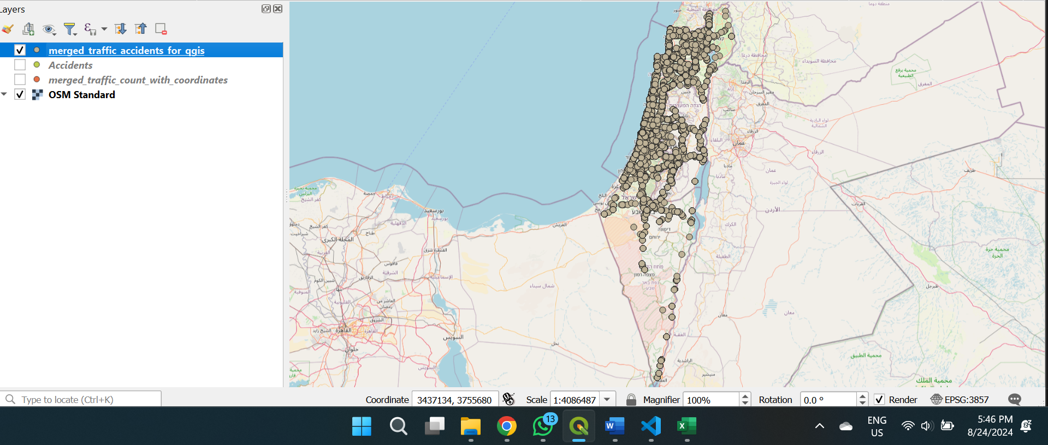
QGIS: Accidentes map after merging
Each point is an accident that has the average traffic count for the day of the accident.

Slide 14
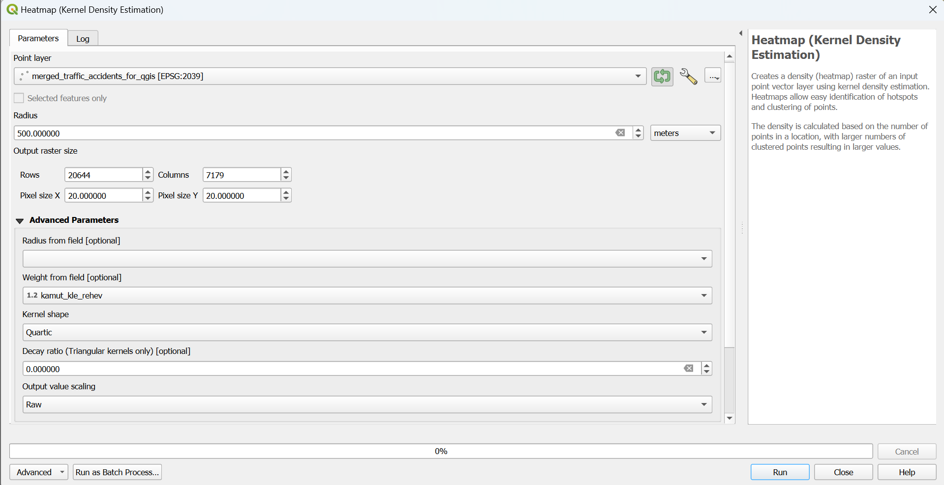
QGIS: Heat Map
Next, we created a heat map!

Slide 15
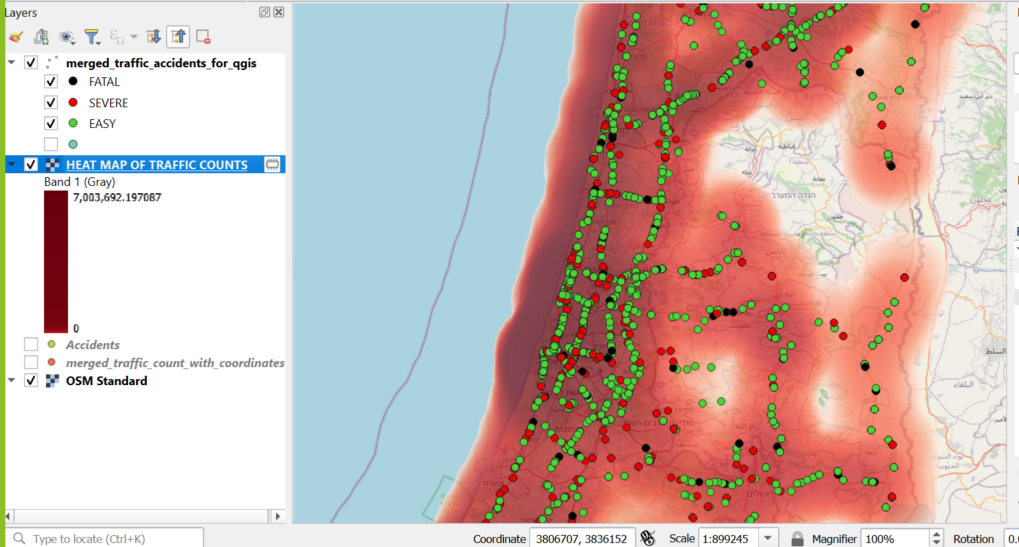
QGIS: Heat Map
Here we can see all the areas with traffic concentration.

Slide 16
What about the other years?
Now that we have proved that we can work with the data of 2021 and before jumping to any conclusions we considered the following:-
Conclusion may be not accurate if look at one specific year (e.g. corona 2020).
We don’t have enough data points to make the analysis worth while.
It is lazy to only work with one year.
Therefor, we decided to clean and merge the data for all years as we did for 2021, it only costed us our sanity.

Slide 17
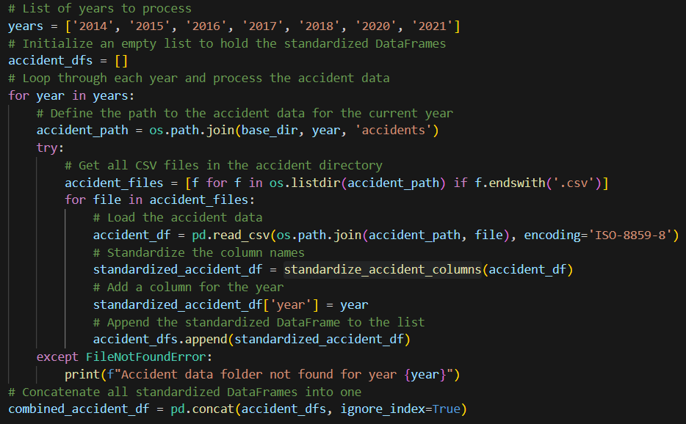
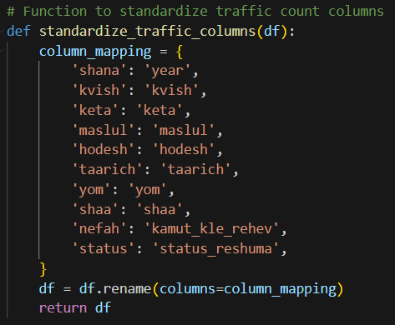
Pre-processing The Data -> Python Notebook
Notes:
אילת
את כל קוד הפייתון הרצנו בקולאב.
השלב הראשון בהתמודדות עם הקבצים היה מחיקת מידע לא רלוונטי: שורות none, עמודות לא רלוונטיות, עמודות כפולות וכו'. יצרנו לשם כך את הפונקציות הגנריות שניתן לראות כאן. בנוסף בשביל פיתוח עמוד האינטרנט הוספנו את הפונקציות ששומרות את המידע לjson או לgeojson.
את קוד הניקוי הראשוני לקובץ הגילאים ניתן לראות למעלה, מאחר ומדובר בקובץ המכיל מידע גאוגרפי השתמשנו בgeopandas על מנת לקרוא אותו.את קוד הניקוי הראשוני של קובץ החנויות ניתן לראות למטה, מאחר ומדובר בקובץ אקסל רגיל השתמשנו בpandas.

Slide 18
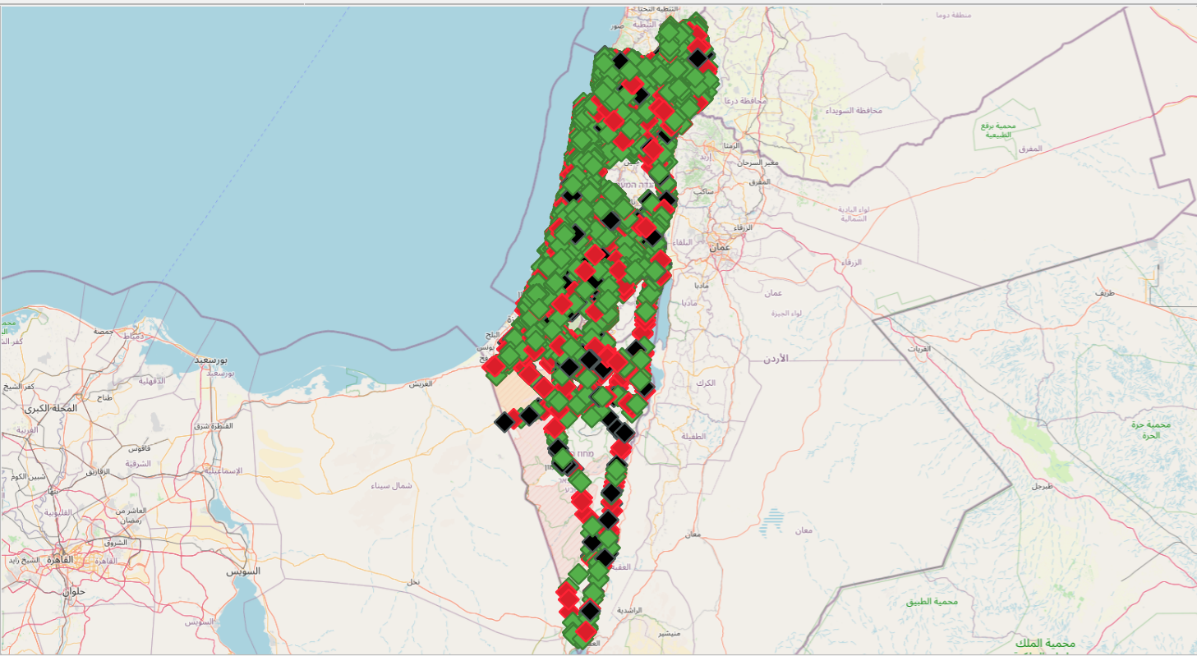
Result: Accidents And Their traffic Count For All Years
Easy
Severe
Fatal

Slide 19
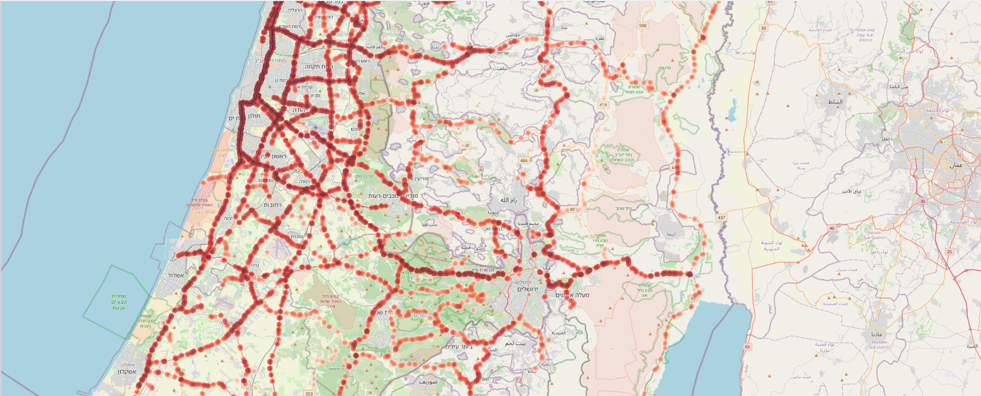
Traffic heatmap

Slide 20
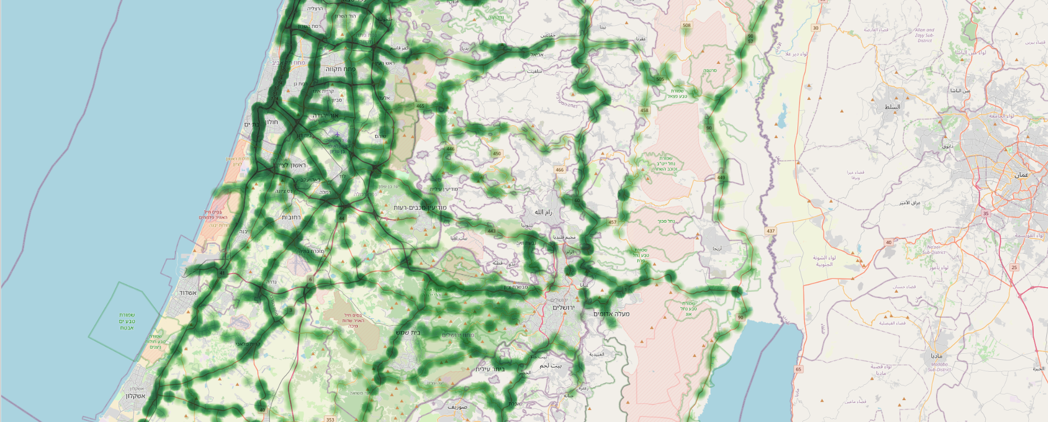
Easy accidents heat map

Slide 21
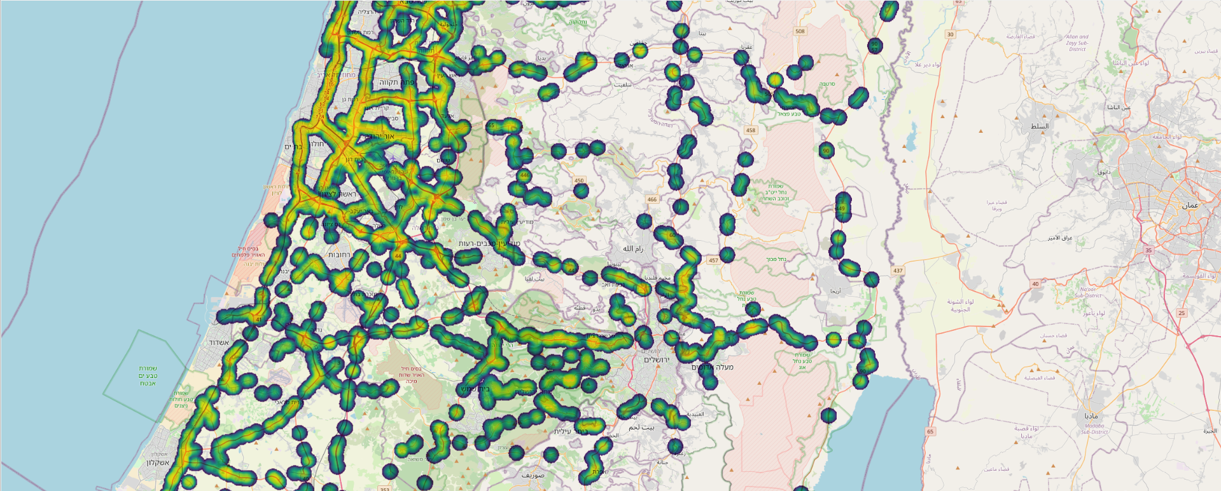
Sever accidents heatmap

Slide 22
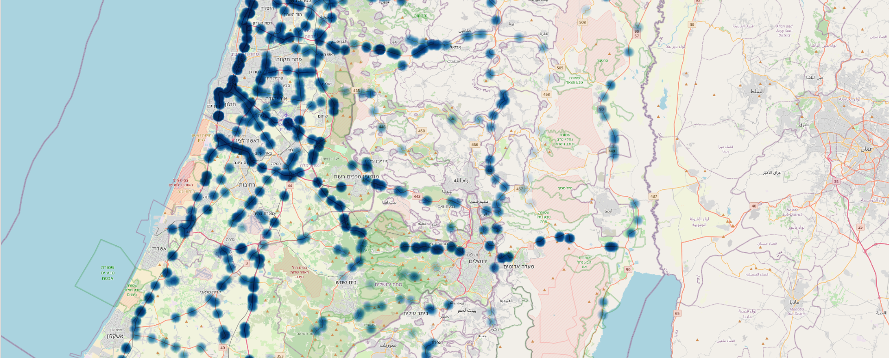
Fatal accidents heatmap

Slide 23
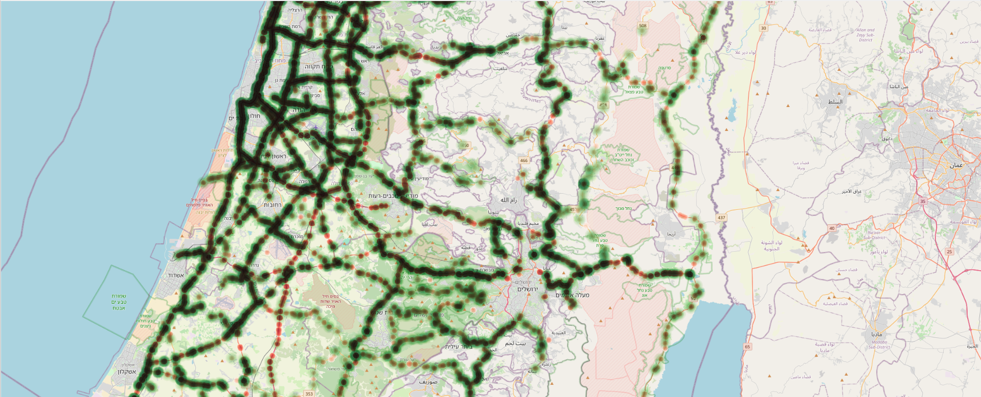
Easy accidents with traffic heatmap

Slide 24
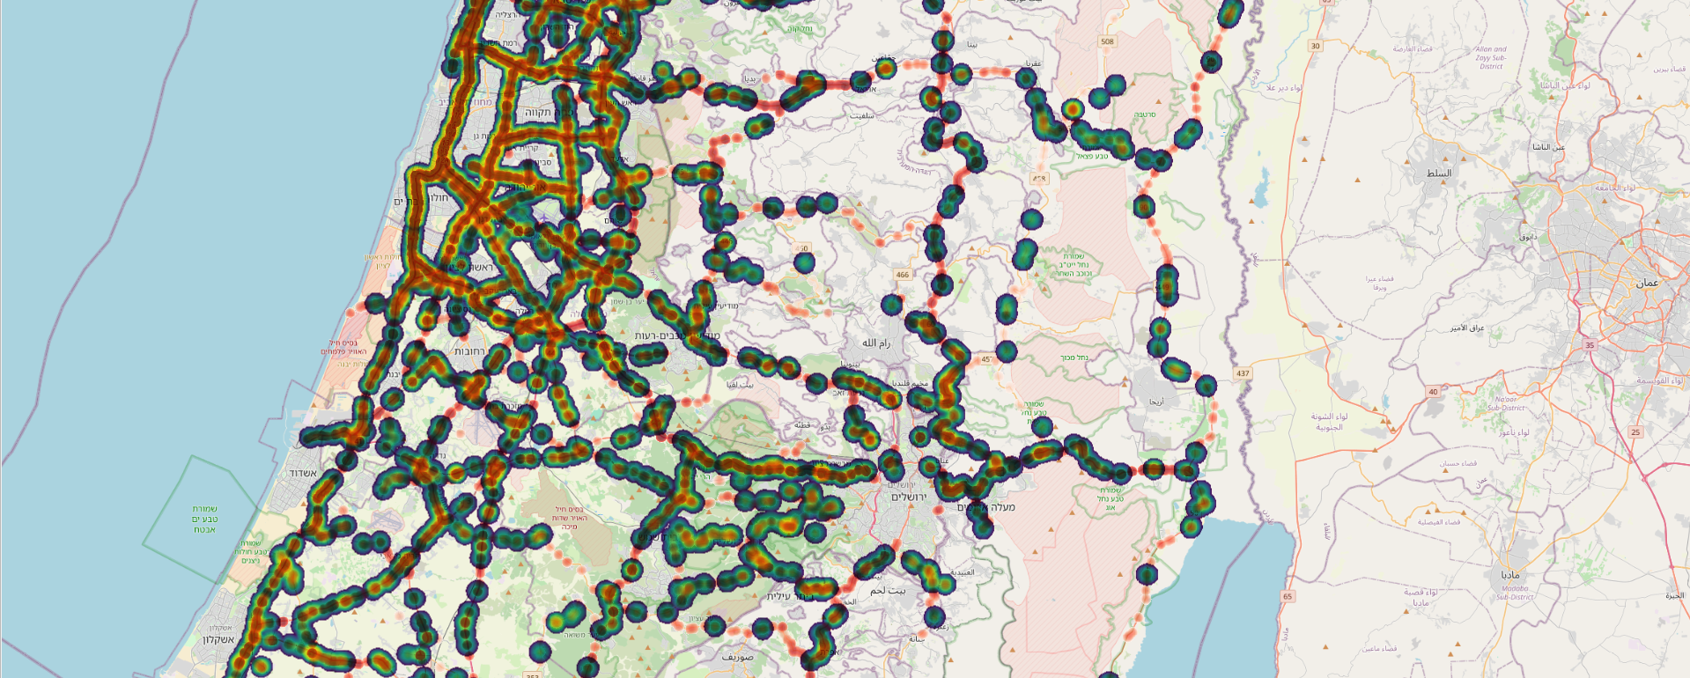
Severe accidents with traffic heatmap

Slide 25
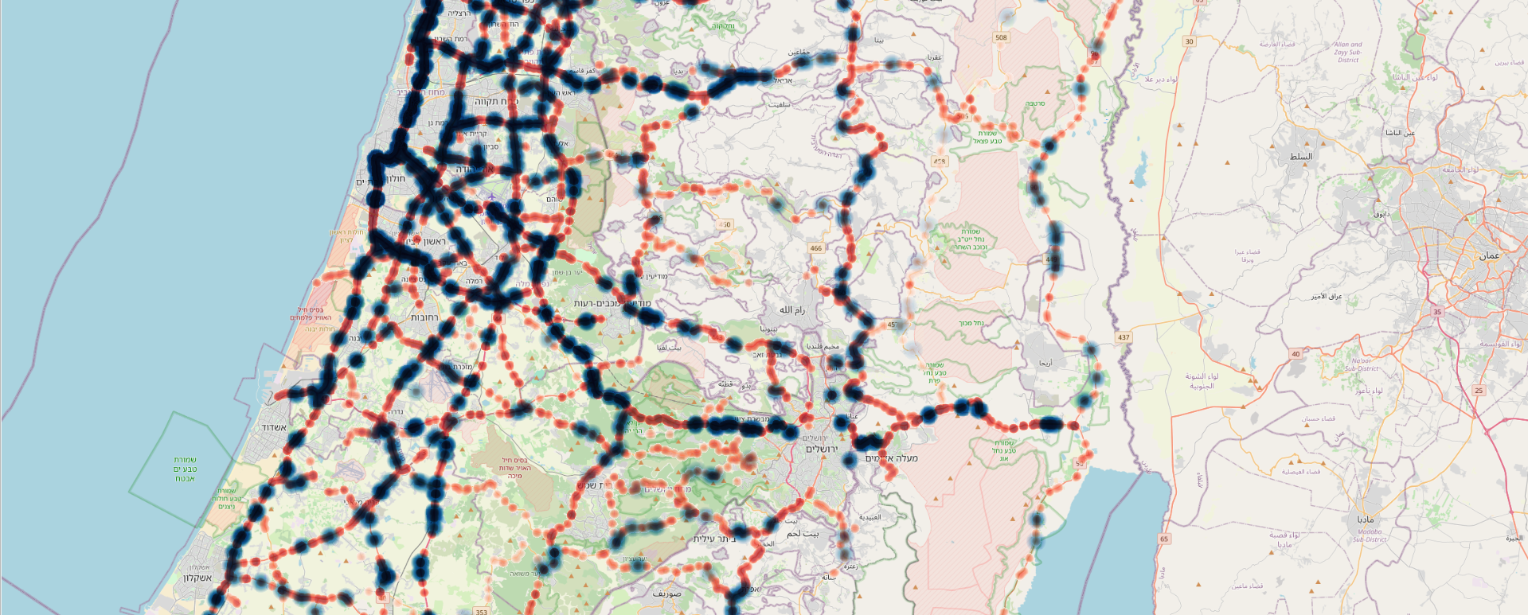
Fatal accidents with traffic heatmap

Slide 26
Conclusions
Traffic Volume & Accident Severity Correlation: Higher traffic volumes tend to correlate with increased accidents of all kinds but especially easy ones.
Spatial Patterns Identification: Certain road segments consistently show high traffic counts and frequent accidents, highlighting them as potential areas for targeted traffic management or road safety improvements.
Impact of Data Aggregation: Analyzing traffic data over multiple years provided a more robust understanding of traffic patterns, minimizing the influence of outlier years like 2020 (due to the COVID-19 pandemic).
Data Integration Challenges: Merging traffic count data with accident records across multiple years was complex but essential for achieving accurate insights, reinforcing the importance of thorough data preprocessing.
QGIS Visualization Power: Mapping the merged data in QGIS offered valuable visual insights, making it easier to communicate findings and identify critical areas for further study or intervention.

Slide 27
Thanks!
Does anyone have any questions?

